Slide 1

Mobile Computing Technology
February, 2025
Notes:
After the midterm

Slide 2
Review
Notes:
https://developer.android.com/codelabs/basic-android-kotlin-compose-first-program?continue=https%3A%2F%2Fdeveloper.android.com%2Fcourses%2Fpathways%2Fandroid-basics-compose-unit-1-pathway-1%23codelab-https%3A%2F%2Fdeveloper.android.com%2Fcodelabs%2Fbasic-android-kotlin-compose-first-program
In Windows, platform tolos are likely to be found under ~\AppData\Local\Android\Sdk\platform-tools

Slide 3
So far we have learnt
Built on top of Linux, but modifies it in substantial ways
Linux kernel plus a full software stack.
At the kernel level, Android is different from Linux in the way IPC, memory management, and logging works.
At the user mode level (i.e., anything that starts running after kernel is loaded), Android provides new services including the Dalvik runtime, the Hardware Abstraction Layer, and system properties
replaces glibc with Bionic, and provides a custom version of init which is the system startup daemon.
Google maintains the frameworks and runtime of the AOSP (Android Open Source Project)

Slide 4
So far we have learnt
We discussed the Android Architecture and compared it to Linux
We clarified terms relevant for our Android discussions
A brief overview of the different Android frameworks without going into the detail
A brief discussion of Android RunTime, Java Native Interface, Dalvik VM, HAL, and the Native Development Kit (NDK)
Explained what native binaries are
Discussions of file system, storage devices and partitions

Slide 5
So far we have learnt
Live experiments
Using ./adb shell
CLI ps, ls, kill,
Df command
Discussion of partitions and Android file system table
Android Standard Partitions, chipset-specific and vendor specific partitions
Some partitions mounted by the bootstrap, some by the init process. After successful boot, information on all mounted partitions accessible via the df command
Getting information on devices and partitions using
The disk free command (df command); df --help
cat /proc/partitions or
browsing /dev/block/platform/name.# directory
Kernel is configured using .rc files stored in various places within the file system, e.g. under /system/etc/init
After system hast started, the file system table is available under /vendor/etc and can be viewed using cat fstab.ranchu
Notes:
The "disk free" command shows total/used/available disk space for each filesystem listed on the command line, or all currently mounted filesystems.
Learn about Android fstab file. Learn about the file system manager flags fs_mgr_flags
avb=vbmeta,first_stage_mount

Slide 6
So far we have learnt
A discussion of the root file system
/init; /system; /vendor; /vendor/etc; /data; /config; /dev;
Phones storage data can be found under /storage/
Example: /storage/1408-101D/Documents
SDCard under /sdcard which is a link to /storage/self/primary
A discussion of the boot process
What is a boot partition, bootable file system
The boot process
Bootstrap loader, bootstrap program
The init program
The boot process in Linux
Boot process in Android
What is the Generic Kernel Image
A brief overview of the GKI Architecture
The Init process (a mobile OS service)
Backup and Recovery
New concepts in Android
The Backup Manager (a mobile OS service)
Notes:
The "disk free" command shows total/used/available disk space for each filesystem listed on the command line, or all currently mounted filesystems.
Learn about Android fstab file. Learn about the file system manager flags fs_mgr_flags
avb=vbmeta,first_stage_mount

Slide 7
What is next?
1) Android App Development using Kotlin and Compose
4 to 5 weeks
See updated syllabus in D2L
Interactive sessions like a lab
Learning by doing
Using Android developer resources
Notes:
https://developer.android.com/courses/android-basics-compose/course

Slide 8
What is next?
2) Some more in-depth Android discussions towards the end of the term (depending on our progress)
Android Interface Definition Language (AIDL)
Android RPC (a mobile OS service)
Android Threads and Android Thread Pools

Slide 9
Building native UI in Android
https://developer.android.com
https://developer.android.com/studio/intro
Notes:
https://developer.android.com/codelabs/basic-android-kotlin-compose-first-program?continue=https%3A%2F%2Fdeveloper.android.com%2Fcourses%2Fpathways%2Fandroid-basics-compose-unit-1-pathway-1%23codelab-https%3A%2F%2Fdeveloper.android.com%2Fcodelabs%2Fbasic-android-kotlin-compose-first-program

Slide 10
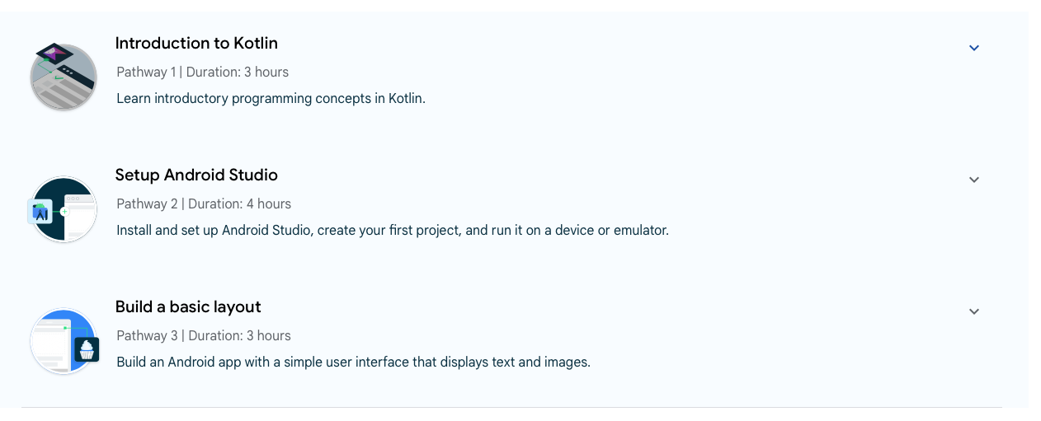
Learning Objectives
Unit 1: Your first Android app
Now
After the midterm

Slide 11
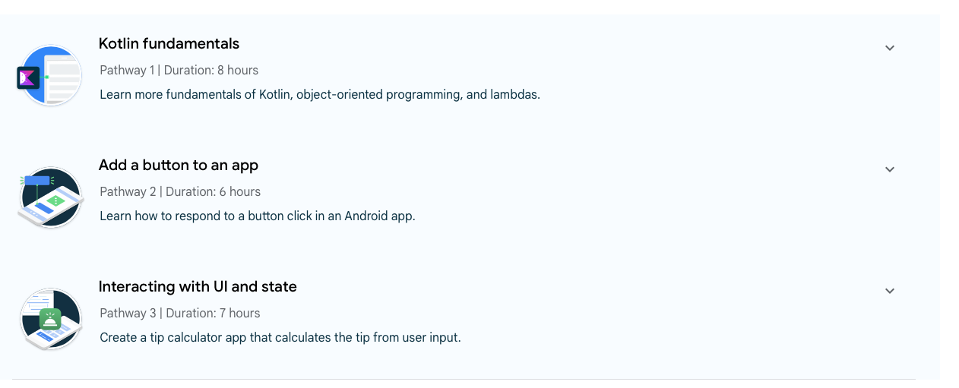
Learning Objectives
Unit 2: Building app UI
After the midterm
After the midterm
After the midterm
Notes:
Continue learning the fundamentals of Kotlin, and start building more interactive apps. Use conditionals, function types, classes, and lambda expressions in Kotlin.
Understand how composition and recompositing works.
Add a button to an app UI and respond to user taps.
Create an app that works with data entered by the user.
Learn how to use state to display data and reflect the changes automatically when the data gets updated.
Write unit tests to test isolated functions.
Potentially, brief discussions of data management and accessing hardware such as GPS, accelerometer and compass

Slide 12
Kotlin
Programming language concepts in

Slide 13
Kotlin
The language recommended by Google when creating new Android apps
Kotlin Playground
Notes:
open the browser and try the following tool: https://developer.android.com/training/kotlinplayground

Slide 14
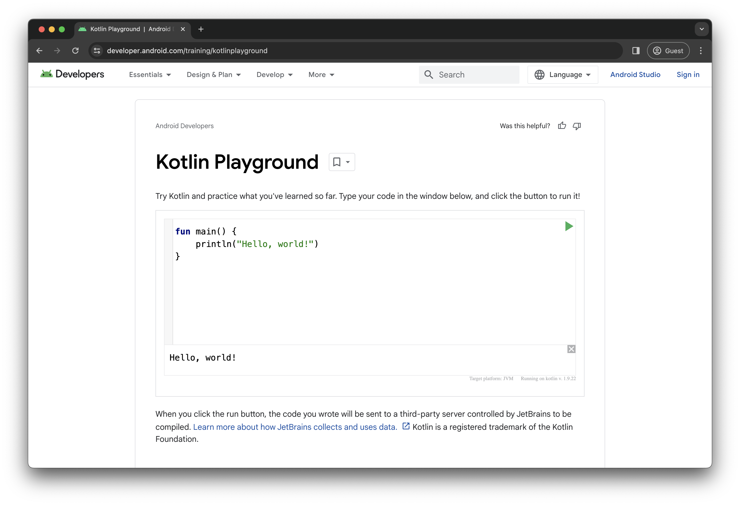


Kotlin Playground – Online Compiler
Notes:
open the browser and try the following tool: https://developer.android.com/training/kotlinplayground

Slide 15
Kotlin – “Hello, world!”
fun main() {
println("Hello, world!")
}
Kotlin is a compiled language
main() is the entry point
Similar to main() in C or _start: in Assembly
Notes:
Kotlin compiler
A Kotlin program is required to have a main function, which is the specific place in your code where the program starts running. The main function is the entry point, or starting point, of the program.
A function is a segment of a program that performs a specific task. Your program may have one or more functions.

Slide 16
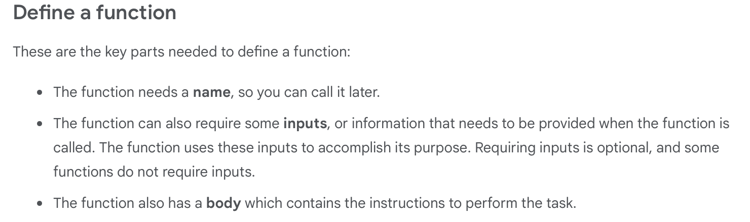
Kotlin functions (subprograms)
Notes:
In Kotlin, declaration and definition of a function are the same; unlike in C

Slide 17
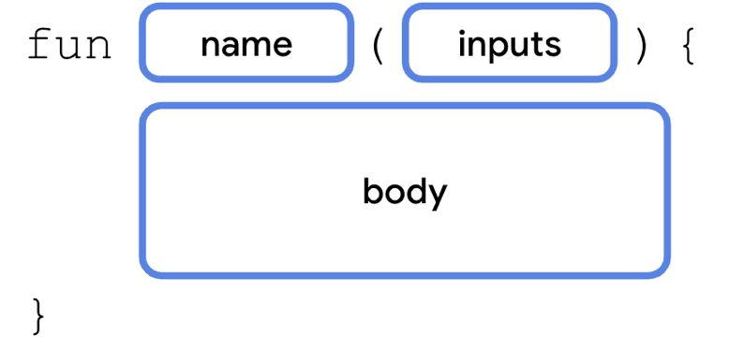
Kotlin functions (subprograms)
Notes:
In Kotlin, declaration and definition of a function are the same; unlike in C

Slide 18
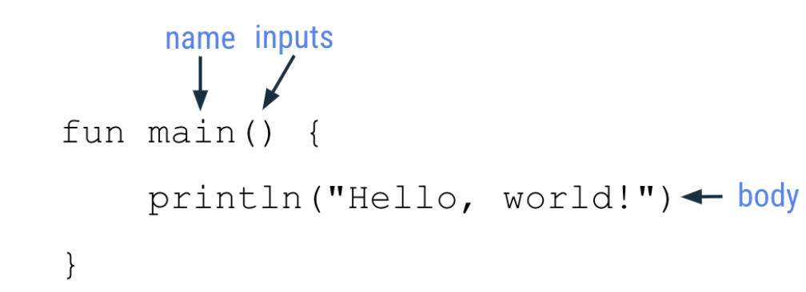
Kotlin functions (subprograms)
Notes:
fun is a special word in Kotlin; used to start a function definition
main is an ‘identifier’. The name is usually a verb or verb phrase. Function names should follow the camel case convention, where the first word of the function name is all lower case. If there are multiple words in the name, there are no spaces between words, and all other words should begin with a capital letter such as ‘displayErrorMessage’
If there are no inputs required for a function, the parentheses are empty (). Just like in C or Java
You can locate the function body by looking for the lines of code enclosed within the opening and closing curly braces.
println() is a function that's already defined in the Kotlin language. The function requires one input, which is the message that should be printed. Place the message text within parentheses after the function name. Be sure to use quotation marks around the text to display, such as "Hello, world!".
No semicolon at the end of a statement. Put each statement on a new line.

Slide 19
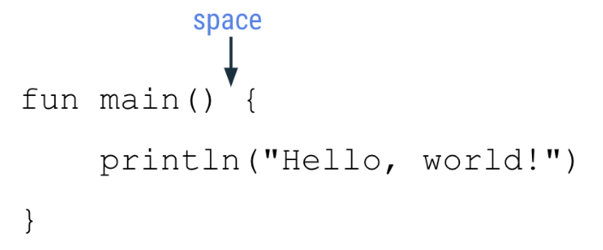

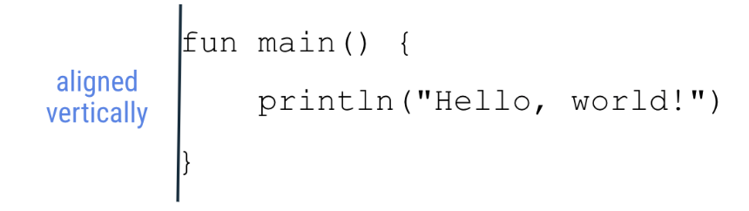
Kotlin Style Guides
Notes:
Function names should be in camel case and should be verbs or verb phrases.
Each statement should be on its own line.
The opening curly brace should appear at the end of the line where the function begins.
There should be a space before the opening curly brace.
https://developer.android.com/kotlin/style-guide

Slide 20
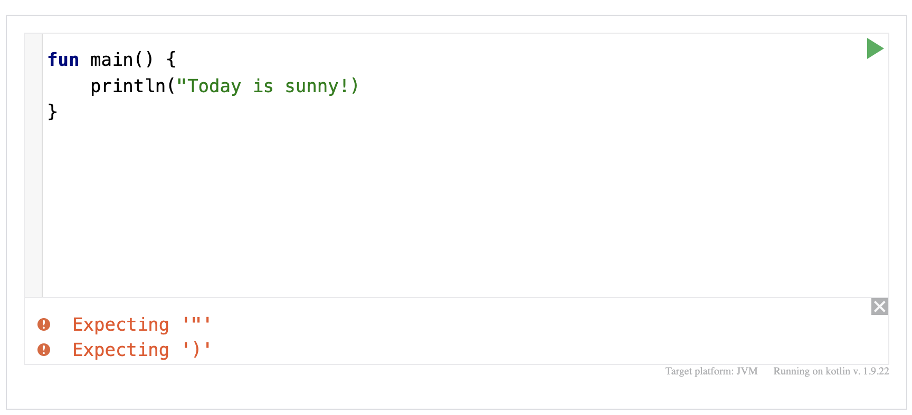
Troubleshooting
Notes:
the compiler is expecting a closing quotation mark and a closing parenthesis for the code on the second line of your program.
The process of solving these errors is called troubleshooting.

Slide 21
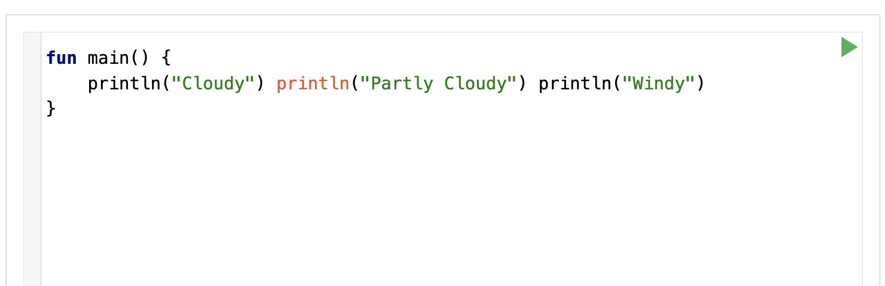
Troubleshooting
Try this code yourself

Slide 22
Android Compose?
What is

Slide 23
Android Compose
Compose is Android's modern toolkit for building native UI, which simplifies and accelerates UI development.
Notes:
Galaxy Emulator Skin
https://developer.samsung.com/galaxy-emulator-skin?download=/emulatorskin/file/062cf10e-798b-4813-ae4e-d406e51f3b6f
https://developer.android.com/studio/intro
https://developer.android.com/courses/pathways/android-basics-compose-unit-1-pathway-3

Slide 24
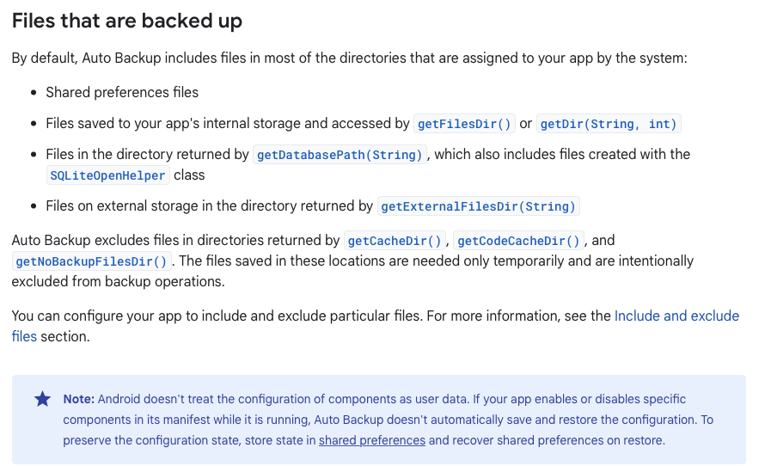
Auto Backup for Apps
Notes:
Auto Backup for Apps automatically backs up a user's data from apps that target and run on Android 6.0 (API level 23) or higher. Apps that target Android 6.0 (API level 23) or higher automatically participate in Auto Backup. You can disable backups by setting android:allowBackup to false (inside AndroidManifest.xml).
Android preserves app data by uploading it to the user's Google Drive, where it's protected by the user's Google account credentials. The backup is end-to-end encrypted on devices running Android 9 or higher using the device's PIN, pattern, or password. The amount of data is limited to 25 MB per user. There's no charge for storing backup data. Your app can customize the backup process or opt out by disabling backups.
Backup data is stored in a private folder in the user's Google Drive account, limited to 25 MB per app.
Backups occur automatically when all of the following conditions are met:
The user has enabled backup on the device. In Android 9, this setting is in Settings > System > Backup.
At least 24 hours have elapsed since the last backup.
The device is idle.
The device is connected to a Wi-Fi network (if the device user hasn't opted in to mobile-data backups).
In practice, these conditions occur roughly every night, but a device might never back up (for example, if it never connects to a network). To conserve network bandwidth, the upload takes place only if the app data has changed.
During Auto Backup, the system shuts down the app to make sure it is no longer writing to the file system. By default, the backup system ignores apps that are running in the foreground to avoid a poor user experience.
To simplify testing, Android includes tools that let you manually initiate a backup of your app. For more information, see Test backup and restore under https://developer.android.com/guide/topics/data/testingbackup
https://developer.android.com/guide/topics/data/autobackup

Slide 25
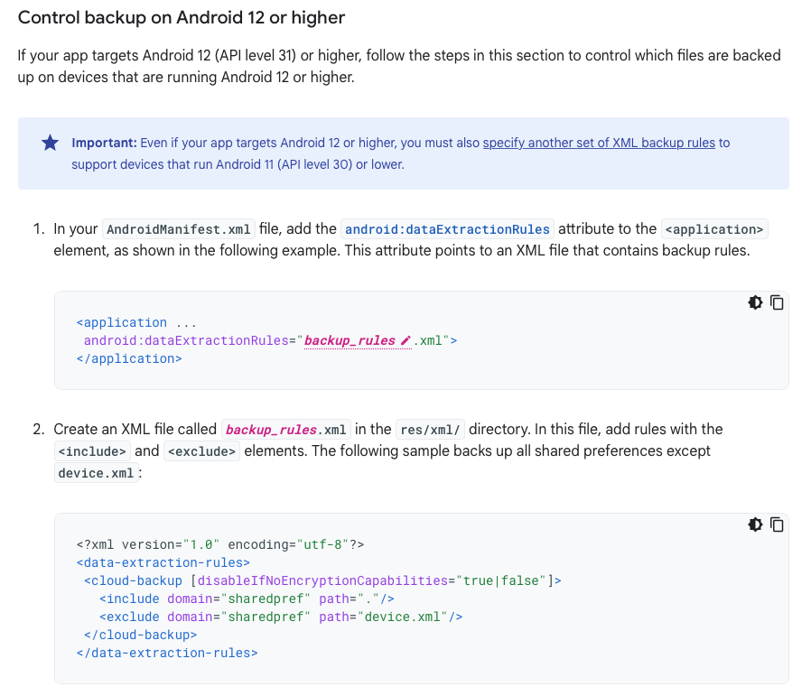
Auto Backup for Apps
Notes:
Apps that implement Auto Backup don't need to implement a BackupAgent. If you implement a BackupAgent, by default the system expects your app to perform key-value backup and restore. To use the file-based Auto Backup instead, set the android:fullBackupOnly attribute to true in your app's manifest.
Example: backs up all shared preferences except device.xml
https://developer.android.com/guide/topics/data/autobackup#include-exclude-android-12

Slide 26
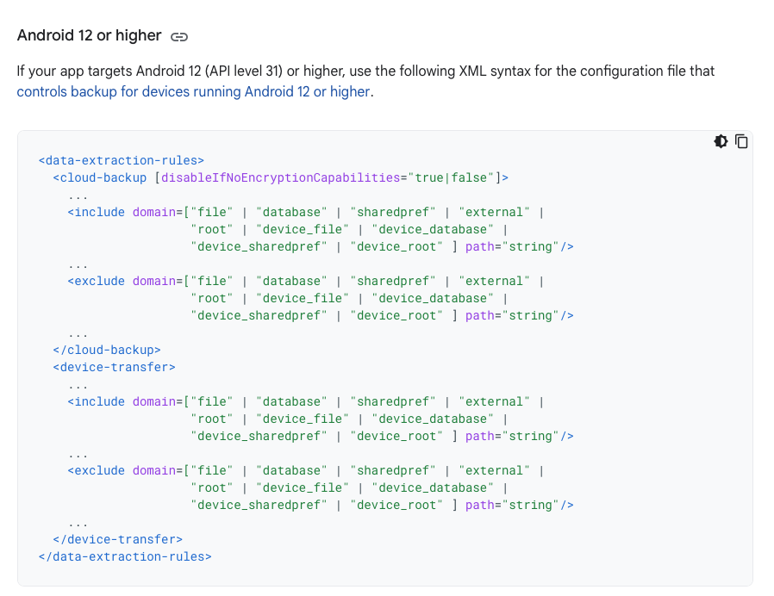
Auto Backup – XML Config Syntax
Notes:
The XML syntax for the configuration file (backup_rules.xml) varies depending on the version of Android that your app is targeting and running on.
Each section of the configuration (<cloud-backup>, <device-transfer>) contains rules that apply only to that type of transfer. This separation lets you, for example, exclude a file or directory from Google Drive backups while still transferring it during device-to-device (D2D) transfers. This is useful if you have files that are too large to back up to the cloud but can be transferred between devices without issue.
If there are no rules for a particular backup mode, such as if the <device-transfer> section is missing, that mode is fully enabled for all content except for no-backup and cache directories, as described in the Files that are backed up section.
Your app can set the disableIfNoEncryptionCapabilities flag in the <cloud-backup> section to make sure the backup happens only if it can be encrypted, such as when the user has a lock screen. Setting this constraint stops backups from being sent to the cloud if the user’s device cannot support encryption, but because D2D transfers aren't sent to the server, they continue to operate even on devices that don't support encryption.
https://developer.android.com/guide/topics/data/autobackup#xml-syntax-android-12
Inside the <full-backup-content>, <cloud-backup>, and <device-transfer> tags (depending on the device's Android version and your app's targetSDKVersion), you can define <include> and <exclude> elements:
<include>
Specifies a file or folder to backup. By default, Auto Backup includes almost all app files. If you specify an <include> element, the system no longer includes any files by default and backs up only the files specified. To include multiple files, use multiple <include> elements.
Files in directories returned by getCacheDir(), getCodeCacheDir(), or getNoBackupFilesDir() are always excluded even if you try to include them.
<exclude>
Specifies a file or folder to exclude during backup. Here are some files that are typically excluded from backup:
Files that have device-specific identifiers, either issued by a server or generated on the device. For example, Firebase Cloud Messaging (FCM) needs to generate a registration token every time a user installs your app on a new device. If the old registration token is restored, the app might behave unexpectedly.
Files related to app debugging.
Large files that cause the app to exceed the 25 MB backup quota.
If your configuration file specifies both elements, then the backup contains everything captured by the <include> elements minus the resources named in the <exclude> elements. In other words, <exclude> takes precedence.
https://developer.android.com/guide/topics/data/autobackup#xml-include-exclude

Slide 27
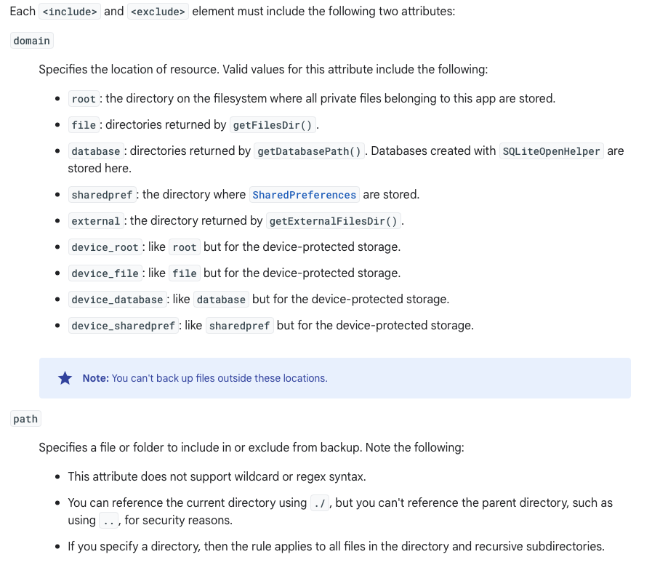
Auto Backup – XML Config Syntax

Slide 28
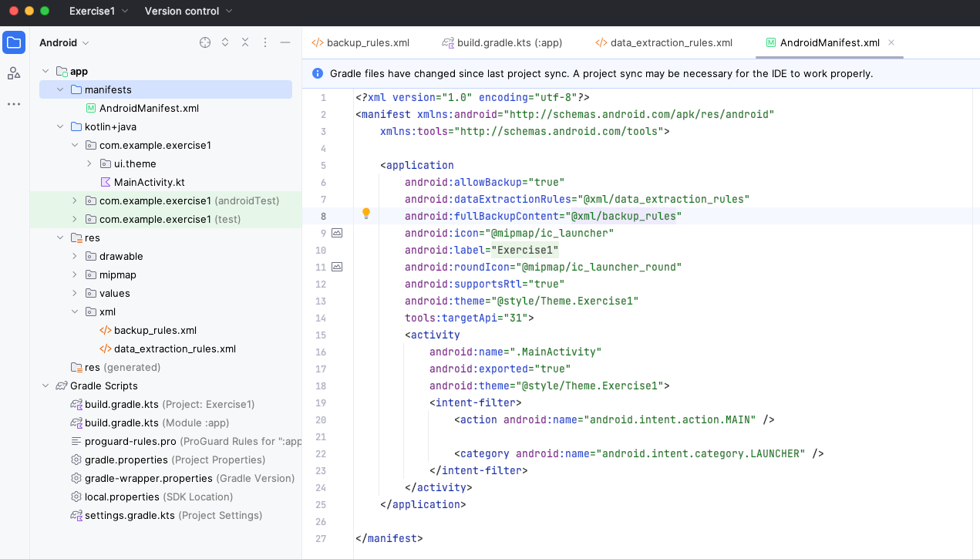
Auto Backup – AndroidManifest.xml

Slide 29
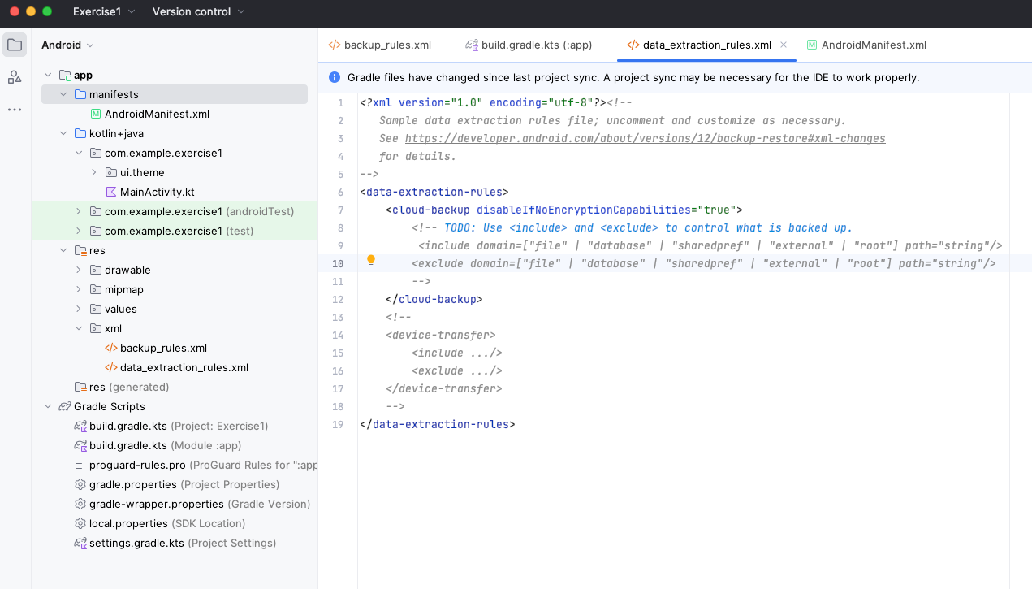
App Backup – rules xml files
Notes:
If your app saves sensitive information on the device, you can specify conditions under which your app's data is included in the user's backup. You can add the following conditions in Android 9 (API level 28) or higher:
clientSideEncryption: the user's backup is encrypted with a client-side secret. This form of encryption is enabled on devices running Android 9 or higher as long as the user has enabled backup in Android 9 or higherand has set a screen lock (PIN, pattern, or password) for their device.
deviceToDeviceTransfer: the user is transferring their backup to another device that supports local device-to-device transfer (for example, Google Pixel).
Note that the target API is specified in AndroidManifest.xml :
<application android:allowBackup="true" android:dataExtractionRules="@xml/data_extraction_rules" android:fullBackupContent="@xml/backup_rules" tools:targetApi="31"> ….. </application>

